Slide 1


Bank of Bhutan
Predicting Defaulters
Done By:
P.S.S.N.Chandra

Slide 2
Introduction
Established by a Royal Charter in May 1968, the Bank of Bhutan (BoB) is the oldest bank in the country.
Registered under the Companies Act of the Kingdom of Bhutan 2000, as a public sector commercial bank, it was the country’s only banking institution until 1997.
BoB provides a wide range of financial products and services, such as deposits, loans, trade finance, and the money market as well as facilitating the financial transactions of customers.
Notes:
Head OfficePost Box No. 102, Babesa, Thimphu
Phone(+975-5) 02-334333
Fax(+975-5) 02-334296
Official Sitewww.bob.bt
SWIFT CodeBHUBBTBT
Founded1968

Slide 3
Predicting Defaulters - dataset
Problem Statement – Those who will default the EMI payment
This dataset is a prerequisite for the creation of prediction model that leads to the resultant in two main categories: 1) People who will pay’s EMI – 0 (Not Defaulter)
2) People who will not pay EMI – 1 (Defaulter).
Several Indicators along with the analysis through several visualization techniques will be presented in the follow up slides.

Slide 4
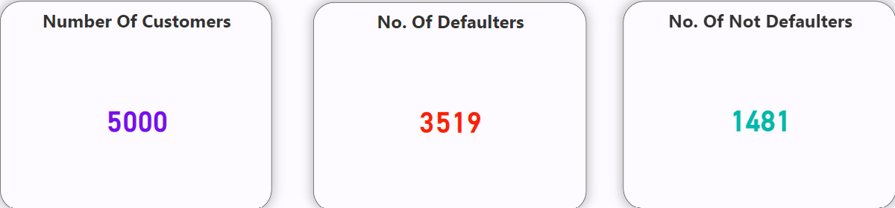
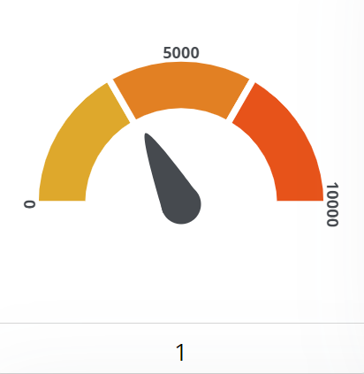
Indicators
Notes:
Number of Customers indicates total number of customers present in accordance with the data available in the dataset
No. of Defaulters indicates the people who did not pay EMI - 1
No. of Not Defaulters indicates the people who pay EMI - 0

Slide 5
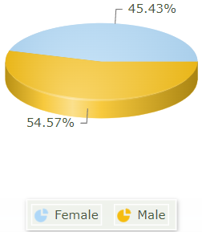
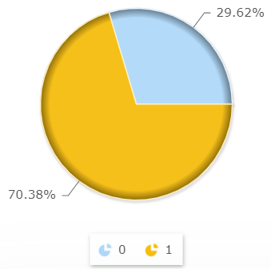
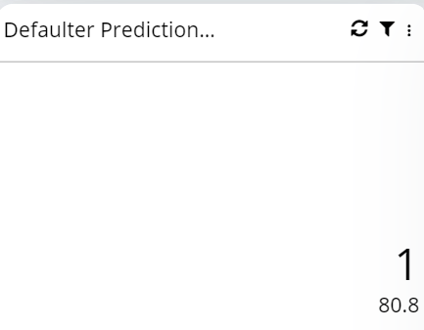
Indicators
Accuracy=

Slide 6
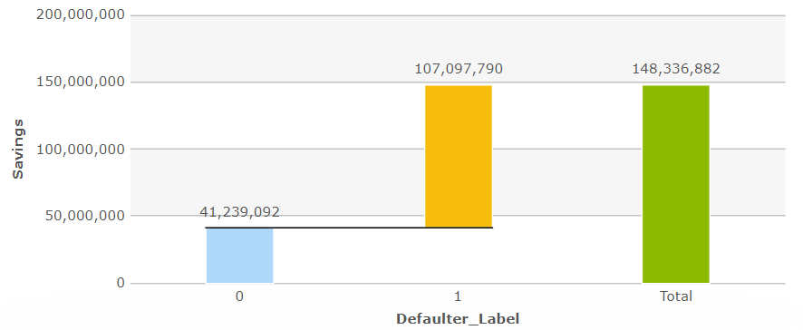
Factors Vs prediction defaulter
Notes:
Here, The Defaulter Label (1) is having a huge amount of savings, when compared with Defaulter Label (0). This happens because, 70% of the data is related to Defaulter Label (1) whereas 30% belongs to Defaulter Label (0) respectively.

Slide 7
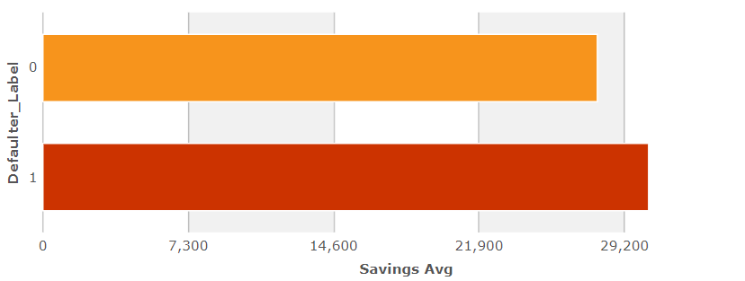
Factors Vs prediction defaulter
27845
30434

Slide 8
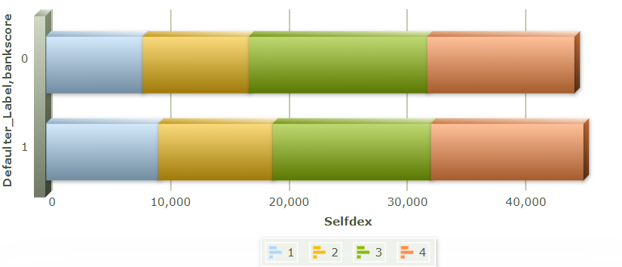
Factors Vs prediction defaulter
8215
8891
15135
12408
9466
9703
13351
12845
Self Declared Expenses
Notes:
Bankscore was classified into 4 types:- 1) Level 1 (Poor) , 2) Level 2 (Average) , 3) Level 3 (Good) , 4) Level 4 (Very Good)
Here Selfdex is term that defined as the amount of money sorted as an expense by customer himself.

Slide 9
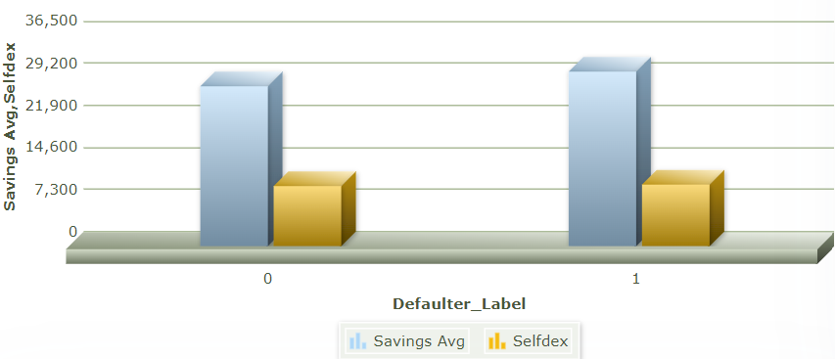
Factors Vs prediction defaulter
30434
27845
10476
10780
Notes:
Here, Comparison of Average Savings and Self Declared Expenses are considered. From which we concluded that there is no peculiar differences between each in the Defaulter Labels.

Slide 10
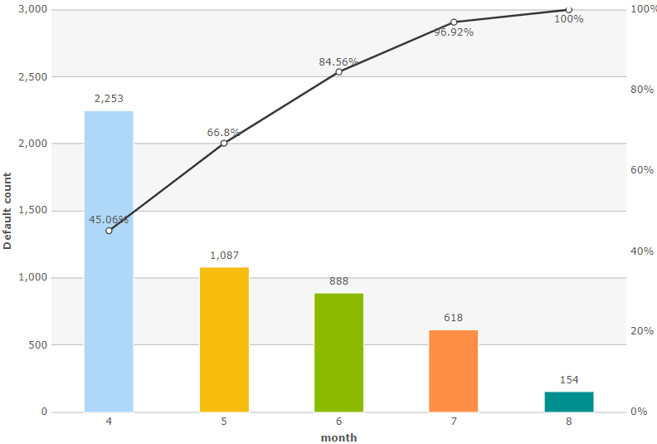
Total Customers Vs month

Slide 11
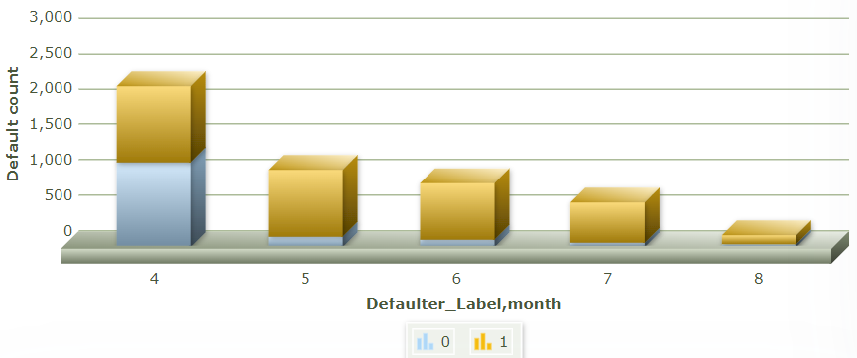
Factors Vs prediction defaulter
1074
1179
952
800
561
132
135
88
57
22

Slide 12
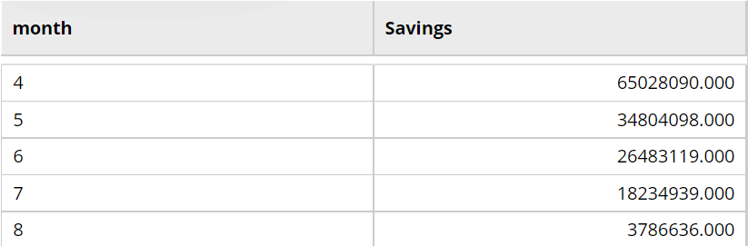
Month Vs Savings

Slide 13
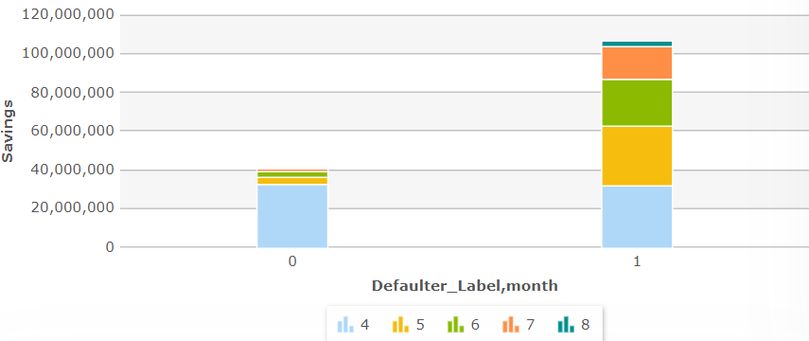
Factors Vs prediction defaulter
Notes:
Total Savings of Month 5,6,7 and 8 are substantially very high in Defaulter Label (1) when compared with Defaulter Label (0).

Slide 14
CONCLUSION
Predicting Defaulter Dataset is having an Accuracy of 80.8%, which was acquired by using XGBoost Machine Learning Algorithm.
We Predicted that the people who will not pay EMI are more than 70% in the available dataset
Average Savings Amount in the account of both categories is approximately equal
Extreme downfall can be seen in the count of Customers predicted in the Defaulter Label (0) after 4th month.

Slide 15
THANK YOU
ANY QUERIES

